Slide 1

Covid-19 vaccine Analysis
and
Prediction
Project By: Shikha Kumari
Guide by: Ms. Arpita Roy

Slide 2
S.no | Content
T | Problem Statement
2. | Project Over View
3 | Why We need this?
4 | How it will help people?
5 | Solution
6 | How it’s unique
7 | Modelling(Analysis Model)And Visualization
8 | Live Demo-Analysis Dashboard
9 | Result(Prediction Model)

Slide 3
Problem Statement
This concise problem statement highlights the key challenge of ensuring the efficient and fair distribution of COVID-19 vaccines.

Slide 4
Project overview
Our project aims to ensure effective distribution, accessibility, and public trust in COVID-19 vaccines, facilitating widespread vaccination and pandemic control.

Slide 5
Why we need this?
The COVID-19 vaccine is crucial in controlling the spread of the virus and mitigating its impact on individuals and communities. Here are some key points:
Preventing Infection:
Protecting Vulnerable Populations:
Reducing Transmission:
Economic Recovery:
Preventing Strain on Healthcare Systems:
Global Public Health:
Boosting Immunity:
Ending the Pandemic:

Slide 6
How it will help people
Accelerating COVID-19 Vaccination: A Lifesaving Initiative
Our project is dedicated to rapidly and efficiently distributing COVID-19 vaccines to the global population. By ensuring widespread vaccination, we aim to curb the spread of the virus, reduce hospitalizations, and save lives. Through strategic outreach and education, we empower communities to make informed decisions about vaccination, fostering immunity and safeguarding public health. Ultimately, our efforts contribute to creating safer environments, restoring normalcy, and offering hope for a healthier future for people around the world.

Slide 7
WHO ARE THE END USERS
The end users of COVID-19 vaccines include various individuals and groups involved in the administration, distribution, and reception of the vaccines. These can include:
Healthcare Workers: Doctors, nurses, pharmacists, and other medical professionals who administer the vaccines to individuals.
Vaccinated Individuals: People who receive the COVID-19 vaccine to protect themselves from the virus.

Slide 8
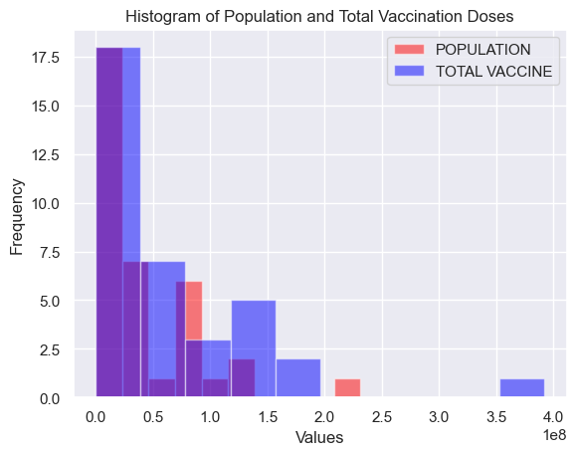
Our Solution To Analyze and Predict The Doses Of Vaccine

Slide 9
What makes your concept unique?
These unique aspects highlight the remarkable collaborative efforts, scientific innovation, and global solidarity that characterize the development and deployment of COVID-19 vaccines.
Rapid Development and Deployment:
Adaptability and Research Advances:
Diverse Vaccine Platforms:
Global Vaccine Equity Initiatives:
Focus on Public Awareness and Education:
Ongoing Research and Monitoring:
Community Engagement and Participation:

Slide 10
Modeling
Take csv file
Then give the full information of csv file
Then we take the back of csv file .
Then we analyses the data
Then we get the result.

Slide 11
DEMO - ANALYSIS DASHBOARD
https://github.com/salu2244/Info-Explorers/blob/main/Covid_19%20Vaccine%20Data%20Analysis%20(1).html

Slide 12
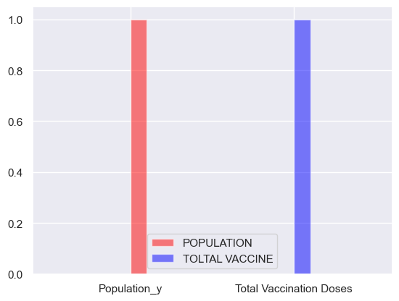
Result
<matplotlib.legend.Legend at 0x250d7caa050>

Slide 13
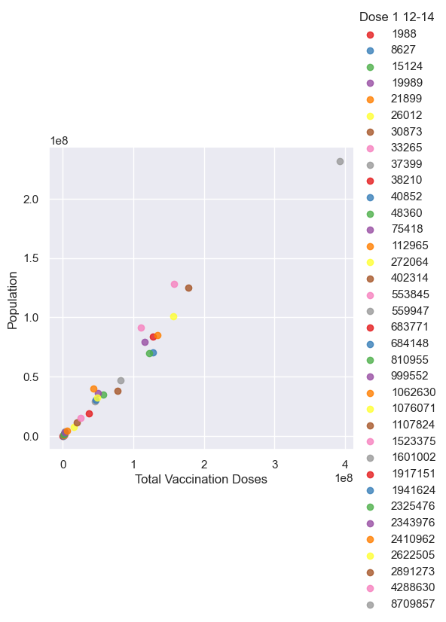
Result
Total vaccination vs Population

Slide 14
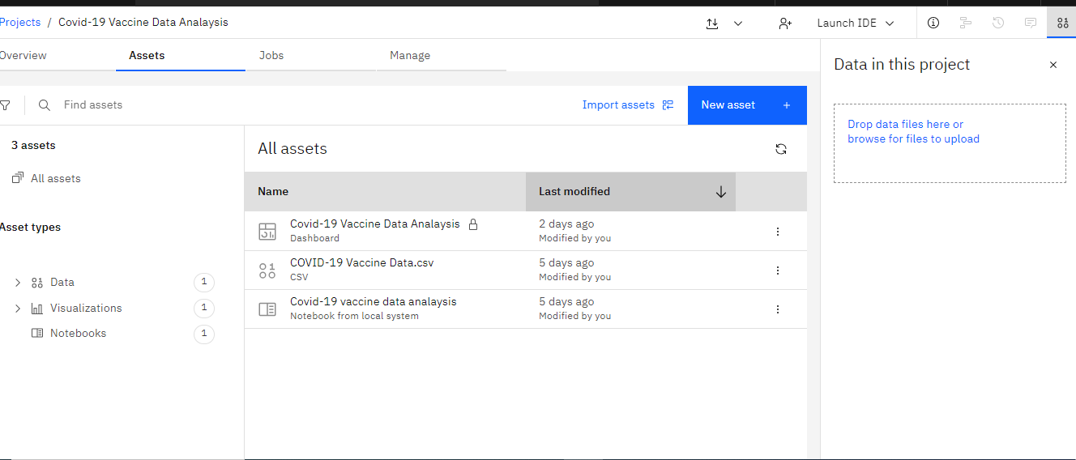
Dashboard

Slide 15
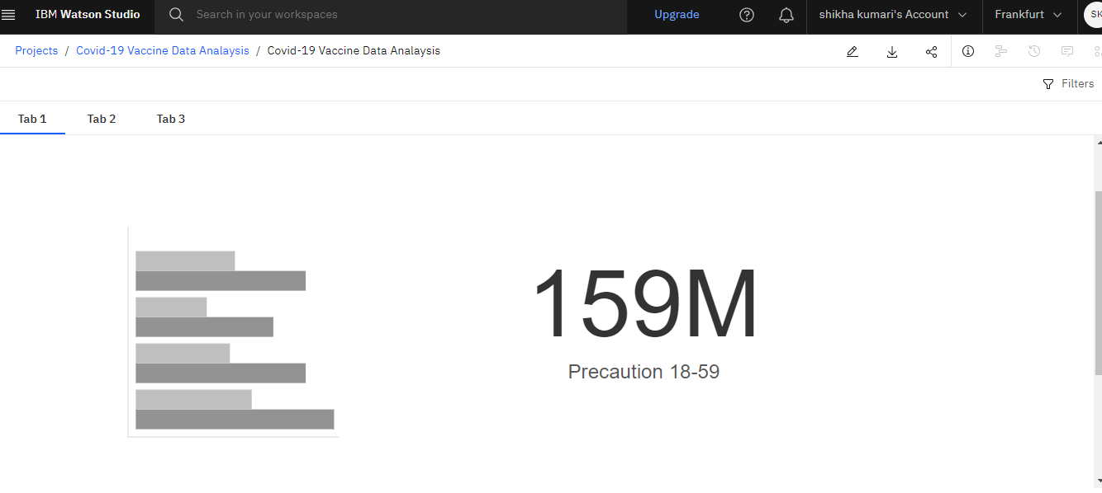
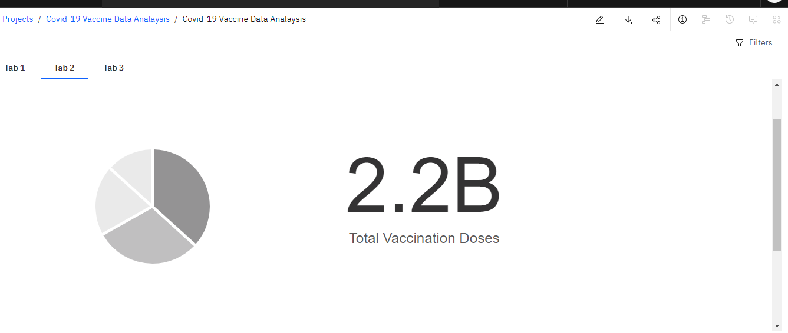
Result

Slide 16
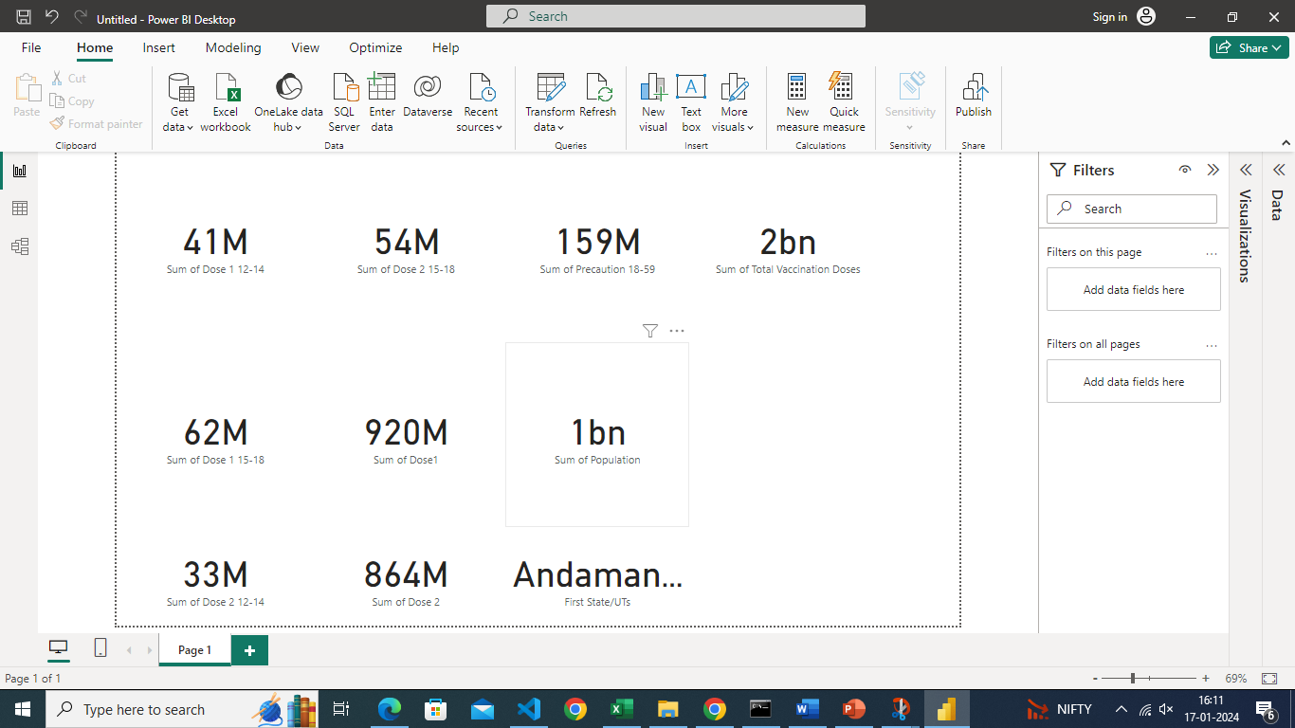
PowerBI

Slide 17
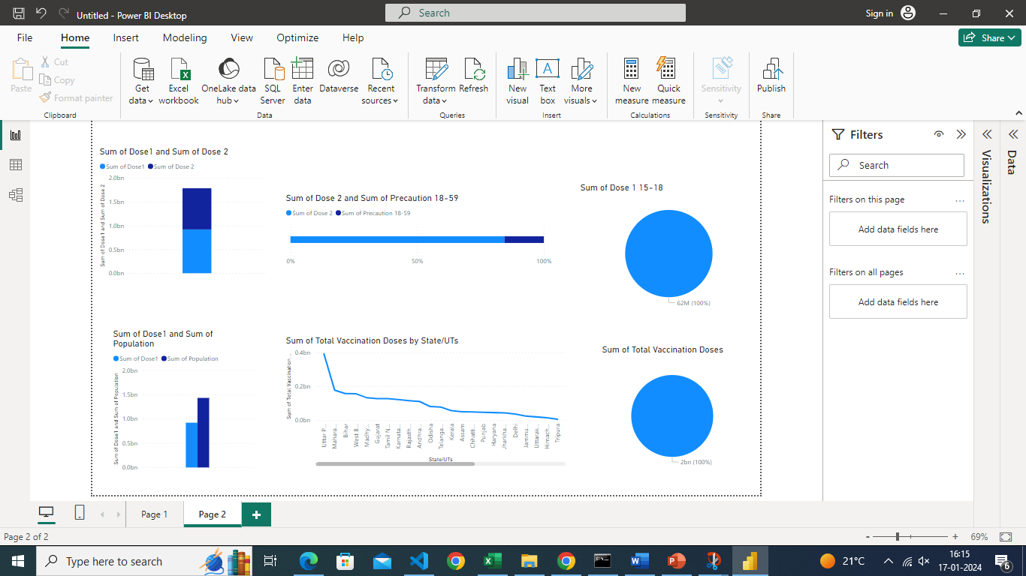
PowerBI

Slide 18

Credit Goes to:
Mentor : Ms. Arpita Roy

